Slide 1
"Blockchain in Action: Redefining Supply Chain Visibility and Accountability"
Group Members:
Karan Acharya (101525308)
Piyush Kotadiya(101516713)
Dwij Amin (101533970)
Smit Patel (101501925)

Slide 2
Business analyst
Implement a blockchain based supply chain management system which ensures transparency ,traceability and efficiency in supply chain process
Business goals:
To improve visibility and tracking in supply chain.
To enhance the security and tamper proof data management.
To automate the business process and reduce the manual errors
To increase the trust and collaboration among stakeholders

Slide 3
Use case: Farm to fork supply chain management
Farmer grows organic products and supply to distributors and it goes to retailers and at last to consumers
Problems:
Lack of transparency.
Food safety.
Inefficient tracking.
Solutions:
Green Harvest creates digital record of produce and blockchain which includes origin, quality and tracking.
Fresh Foods updates: Receive , process and shipping.
Healthy groceries: verify authenticity, quality and freshness.
Benefits:
Transparency
Food Safety
Efficiency
Freshness
Trust

Slide 4
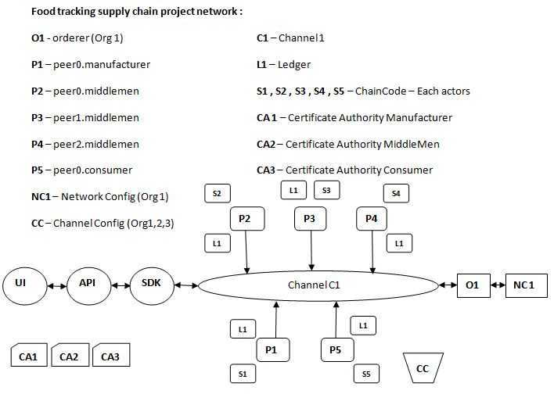
Architecture:

Slide 5
Application flow
Users are enrolled into application by an admin
New Products will be create by the manufacturer only
The product will be sent to wholesaler.
Wholesaler will send the product to the distributor.
Distributor will send to retailer
Consumer could place the order
Consumer will be marked as delivered once the product is delievered

Slide 6
Blockchain Developer:
Chain Code functions:
Create user (Admin)
Sign In (User Login)
Create Product (Manufacturer)
Update Product (Manufacturer , wholesaler , distributor, retailer)
sendToWholeslller
sendToRetailer
sellToConsumer
QueryAsset (Query by product ID)
OrderProduct(Consumer places order, productID
deliveredProduct(Retailer Updates)
Init (Initialize as nil)
Invoke- To invoke each function in the chaincode

Slide 7
Network set up:
Network Architecture:
Peers:2-3 organizations (Manufacturer, Shipper,Retailer)
CA:certificate authority for each organization
Network Components
Peers:
Peer0:Manufacturer
Peer1:Shipper
Peer2:Retailer
Orderer:
Orderer 0:solo orderer
CA:
CA0:manufacturer
CA1:ShipperCA
CA2: retailer CA

Slide 8
DEMO

